Slide 1
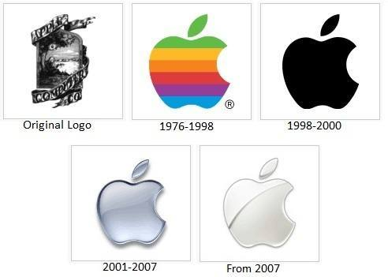
HISTORY OF OPERATING SYSTEM
Sharmin Afrose
Ref: SlideShare

Slide 2
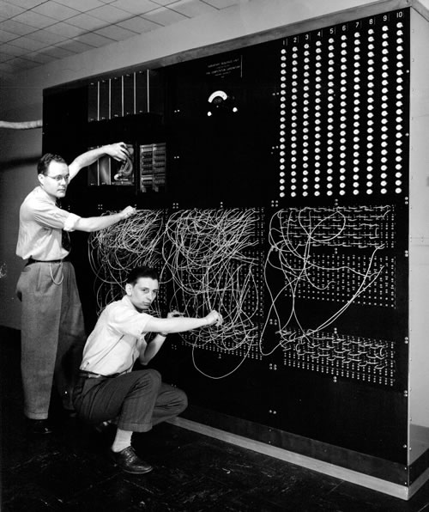
Operating Systems:
History
What were computers like before operating systems were invented?
Before Operating Systems, if you wanted to change what the computer was doing, you had to change how the wires were connected.

Slide 3
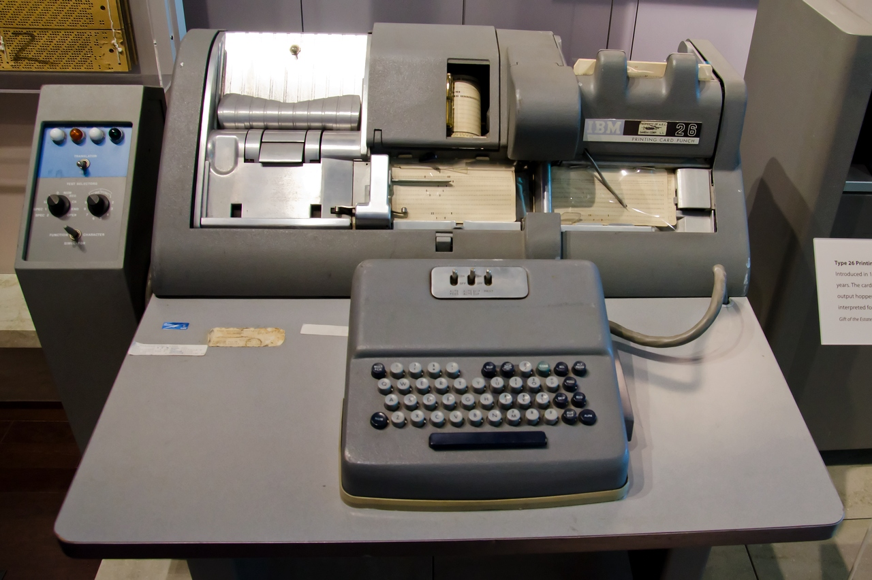
Operating Systems:
History
Later, instructions were given to the computer with punch cards or magnetic tape.
If you wanted to run a different program, you had to wipe out the first program from memory and then load another program into memory.

Slide 4
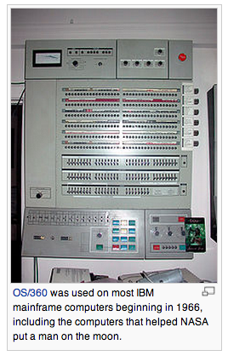
Operating Systems:
History
To run more than one program at a time, you need a "boss" program that controls all the other programs.
Such a boss program is called an operating system.

Slide 5

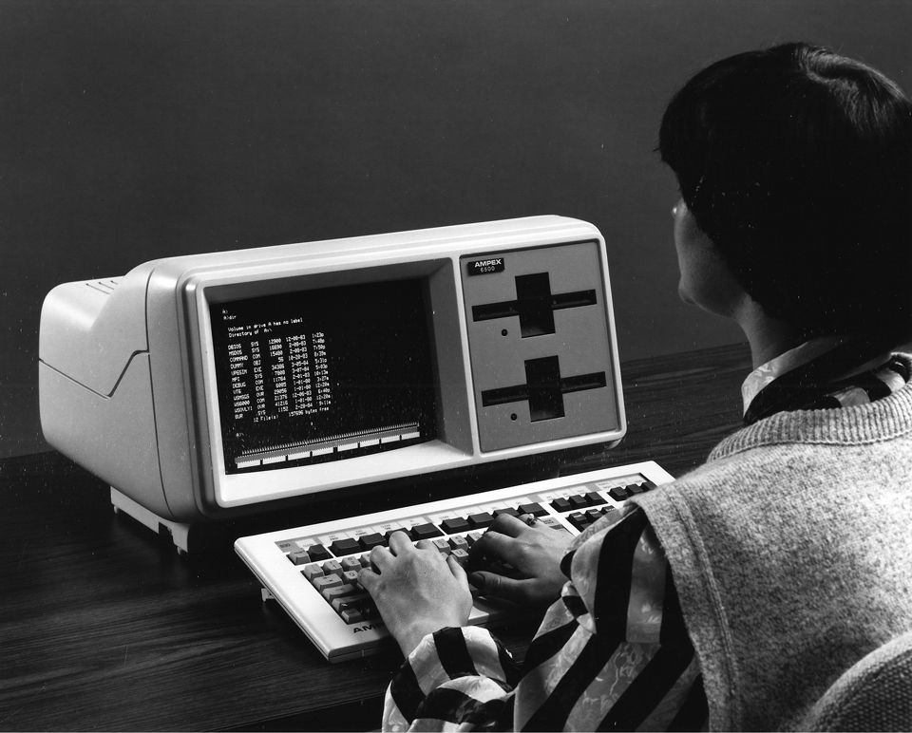
Operating Systems:
Microsoft MS-DOS
Microsoft’s MS-DOS was one of the first Operating Systems for Personal Computers (PCs).
No mouse. Instead, you had to type a lot of special computer commands.

Slide 6
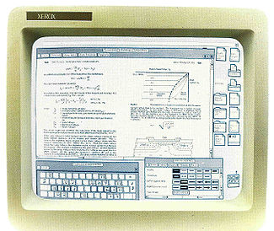
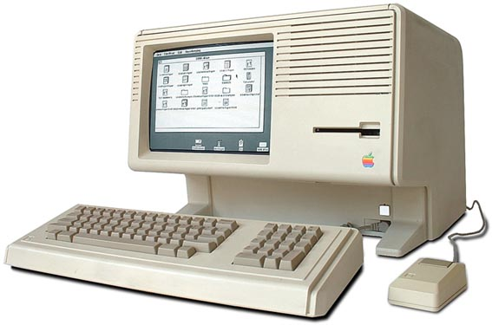
Clicking instead of
typing commands
In the 1980s, operating systems were developed where you could move a mouse around and click on things instead of typing commands.

Slide 7
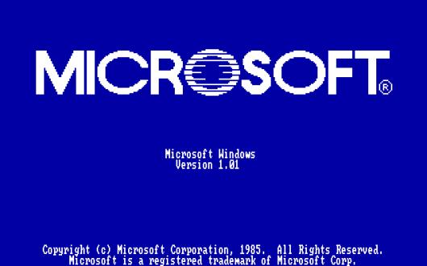
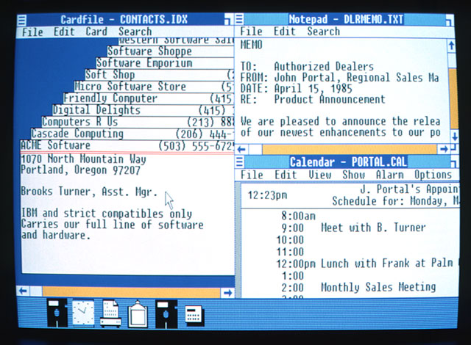
Operating System:
Microsoft Windows 1.0
Windows 1.0 was released on November 20, 1985 as the first version of the Microsoft Windows line. It runs as a graphical, 16-bit mult-tasking shell on top of an existing MS-DOS installation

Slide 8
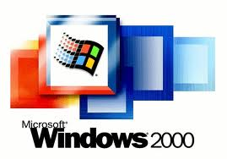
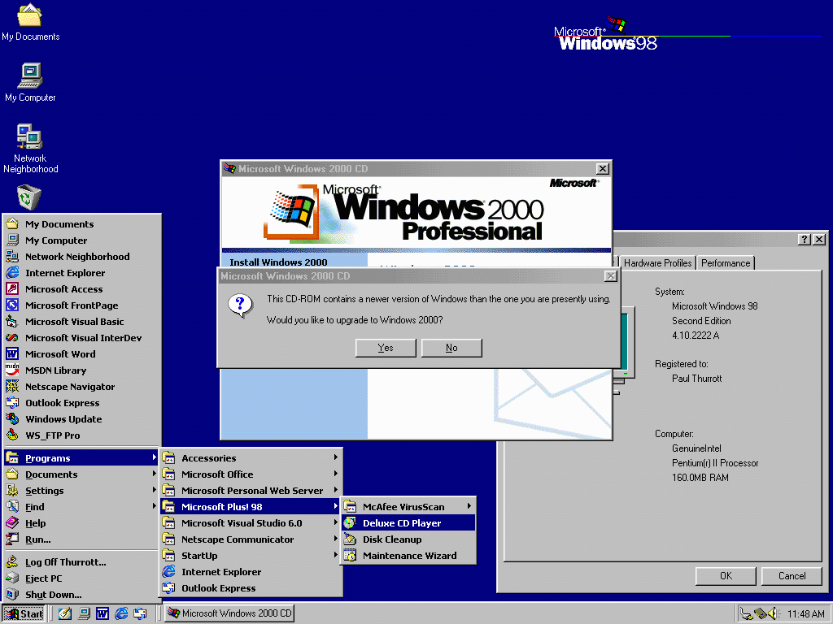
Operating System:
Windows 2000
Windows 2000 is an operating system for use on both client and server computers. It was produced by Microsoft and released to manufacturing on December 15, 1999

Slide 9
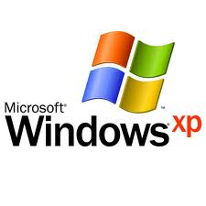
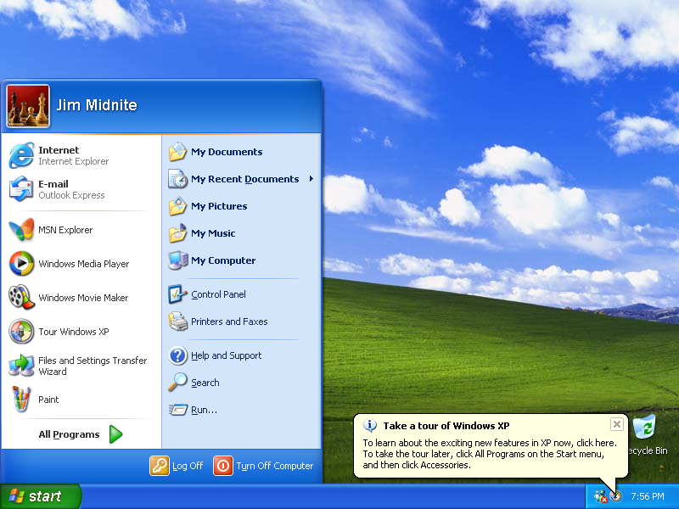
Operating System:
Windows XP
Windows XP (codenamed Whistler) is a personal computer operating system produced by Microsoft
The operating system was released to manufacturing on August 24, 2001

Slide 10
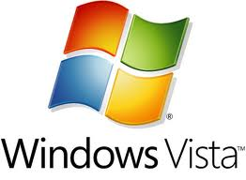
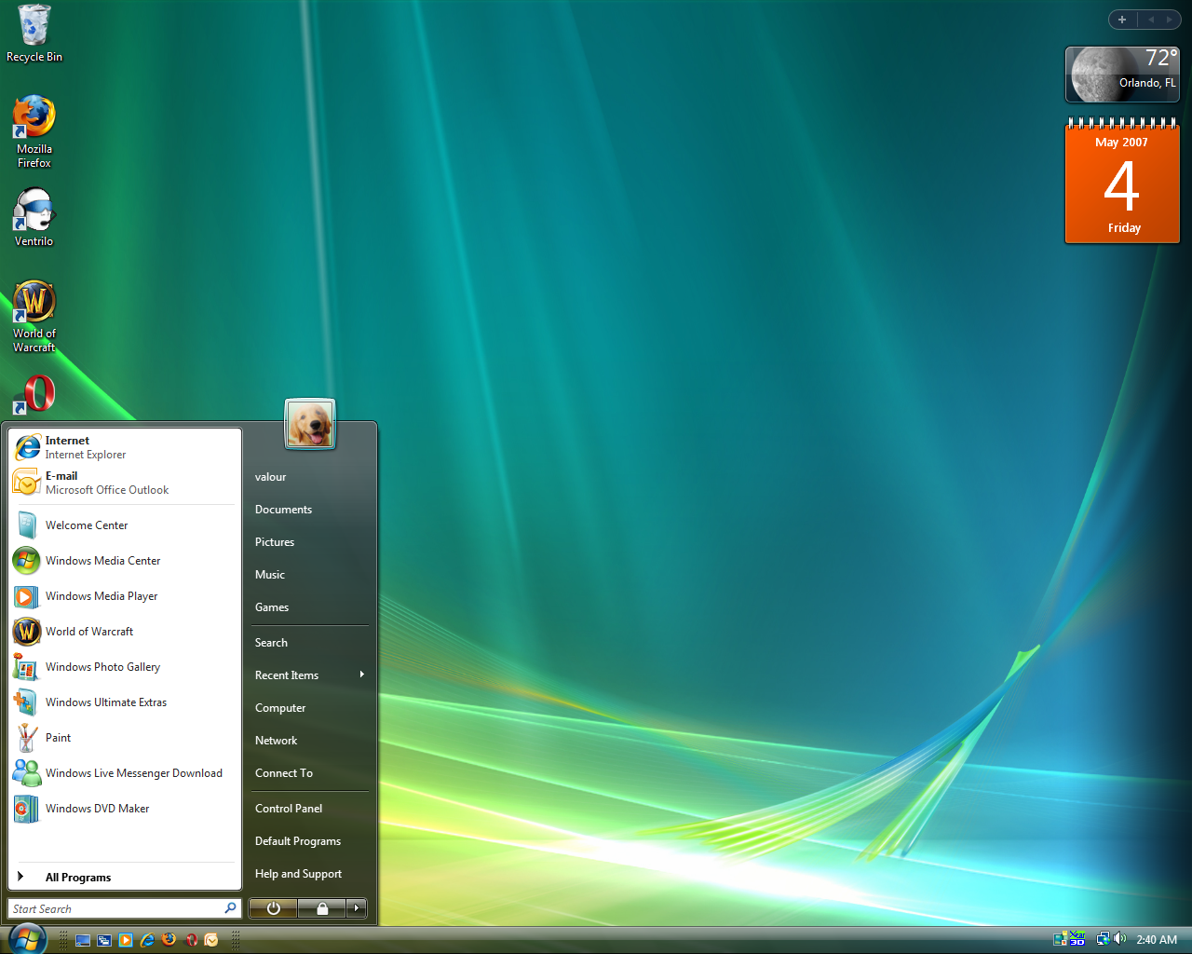
Operating System:
Windows Vista
Windows Vista (codenamed is an operating system by Microsoft for use on personal computers, including home and business desktops, laptops, tablet PCs and media center PCs.
Development was completed on 8,November 2006

Slide 11
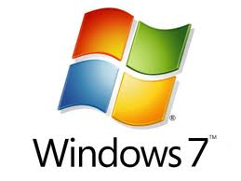
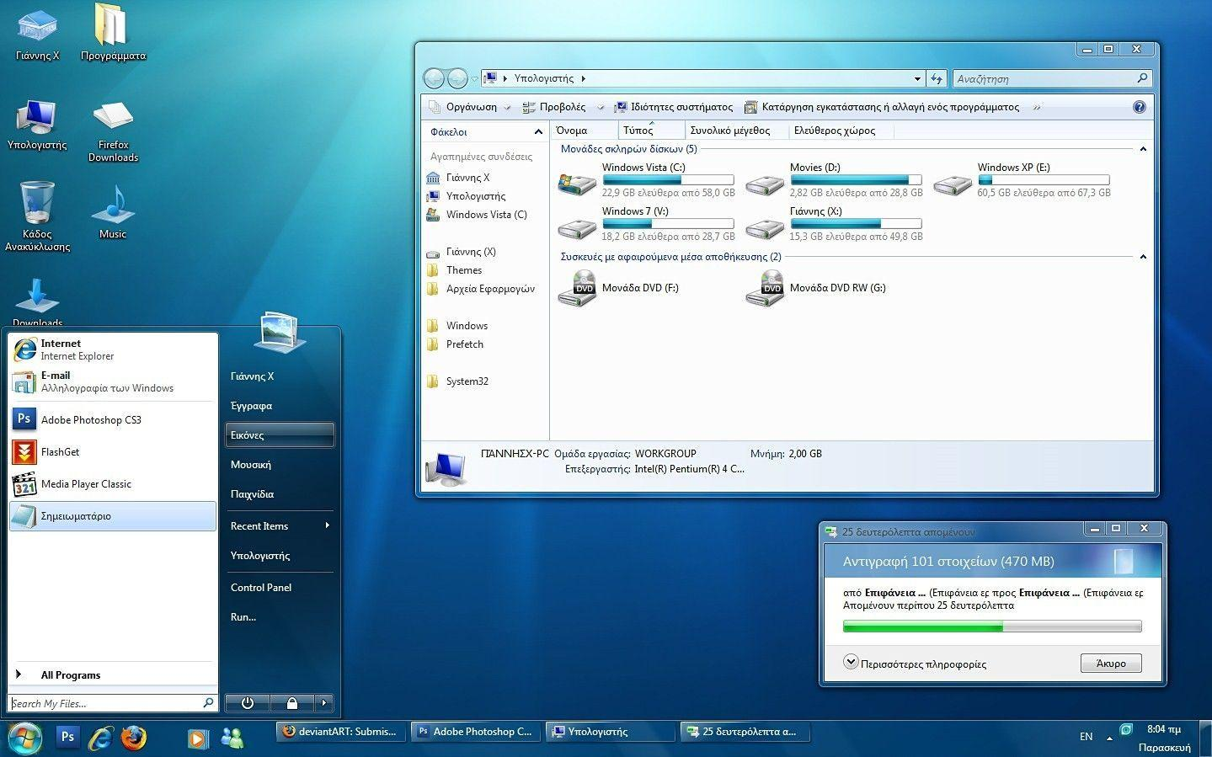
Operating System:
Windows 7
Windows 7 (codenamed Vienna, formerly Blackcomb) is a personal computer operating system developed by Microsoft.
Windows 7 was released to manufacturing on 22 July 2009

Slide 12
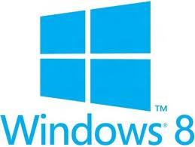
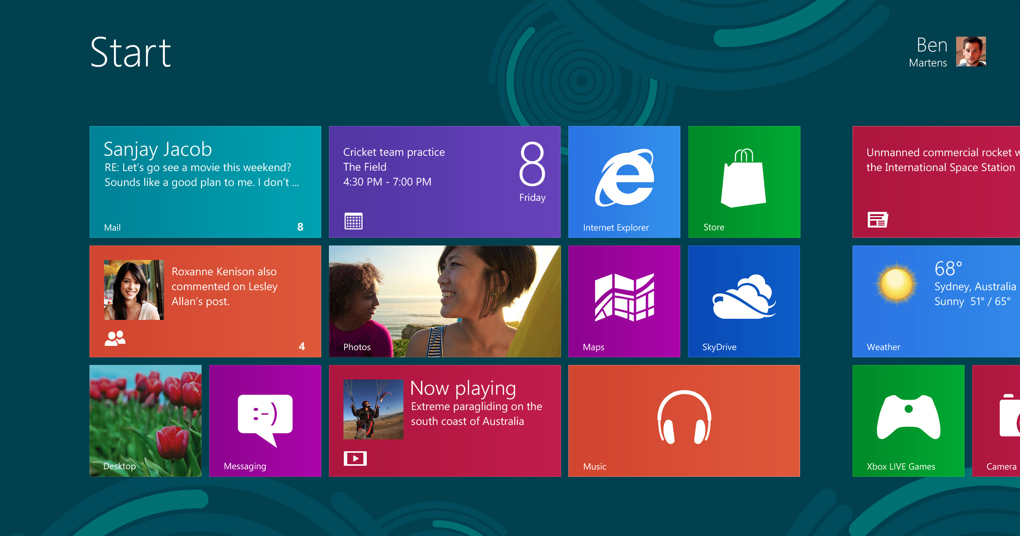
Operating System:
Windows 8
for Laptops and Desktops
Windows 8 is a personal computer operating system developed by Microsoft as part of the Windows NT family of operating systems.
The operating system was released to manufacturing on 1 August 2012

Slide 13
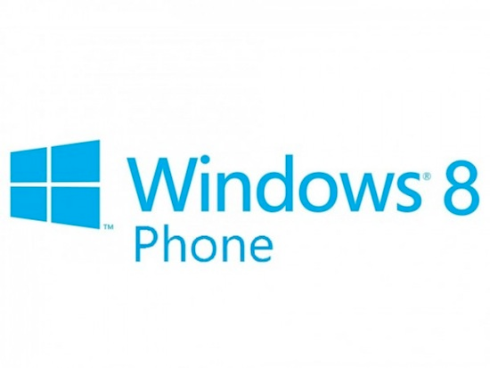
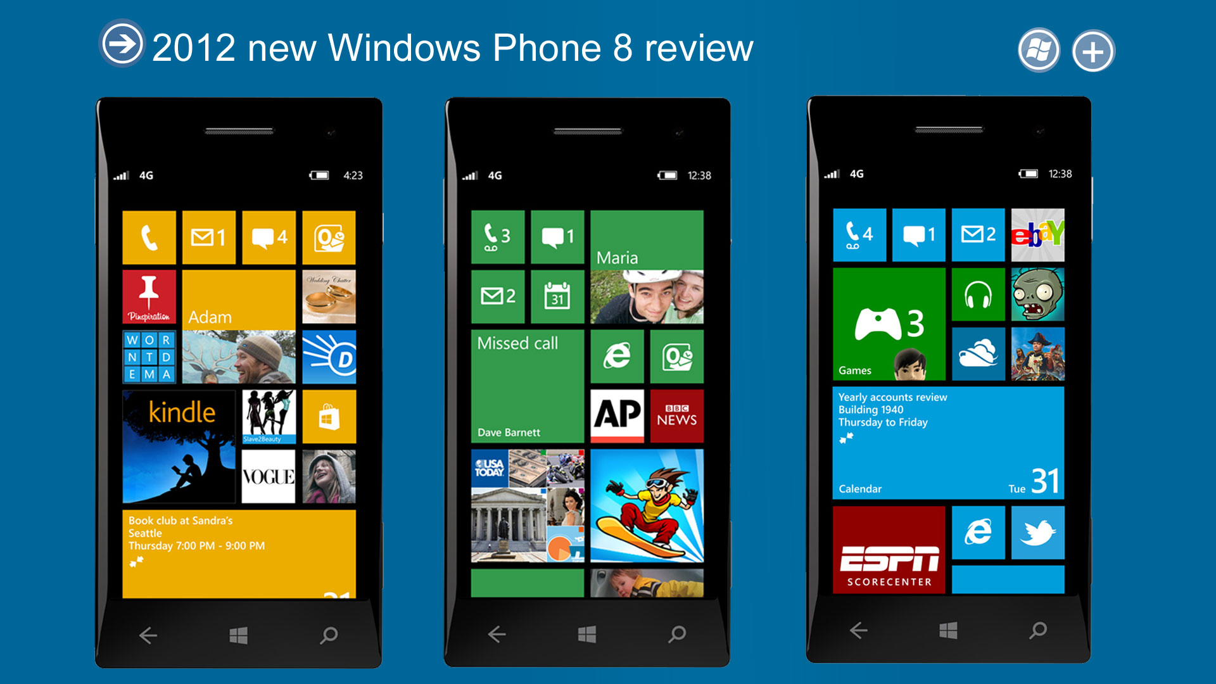
Operating System:
Windows Phone 8
Windows Phone 8 is the second generation of the Windows Phone mobile operating system from Microsoft. It was released on October 29, 2012, and like its predecessor, it features a flat user interface based on Metro design language

Slide 14
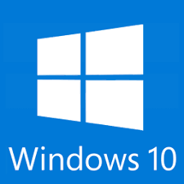
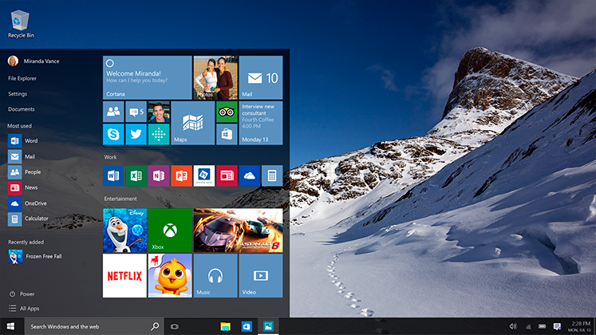
Operating System:
Windows 10
Windows 10 is a personal computer operating system developed by Microsoft as part of the Windows NT family of operating systems. Officially unveiled in September 2014

Slide 15

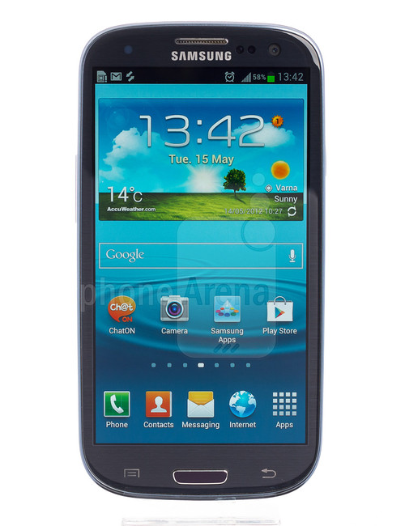
Operating System:
Google Android
for Phones and Tablets
Android is a mobile operating system (OS) based on the Linux kernel and currently developed by Google. With a user interface based on direct manipulation, Android is designed primarily for touchscreen mobile
Initially developed by Android, Inc., which Google bought in 2005, Android was unveiled in 2007.

Slide 16

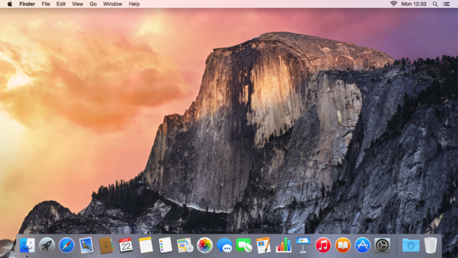
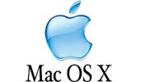
Operating System:
Mac OS X
for Desktops and Laptops

Slide 17
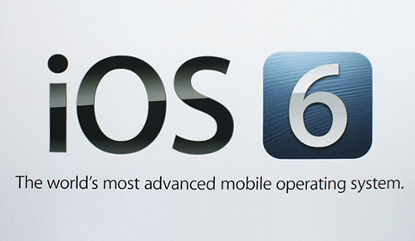
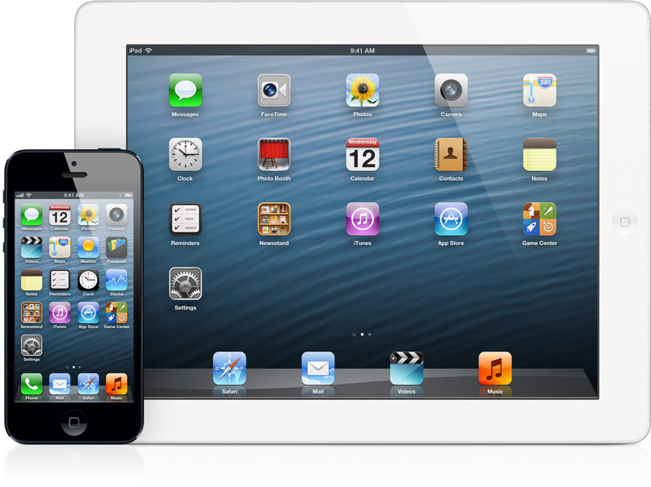
Operating System:
Apple iOS
for Phones and Tablets
iOS is another type of operating system like ANDROID enables users to use smartphones
The main credit of development of iOS’ development goes to STEVE JOBS.

Slide 18
Operating Systems:
History
THANKS

